Slide 1


Slide 2
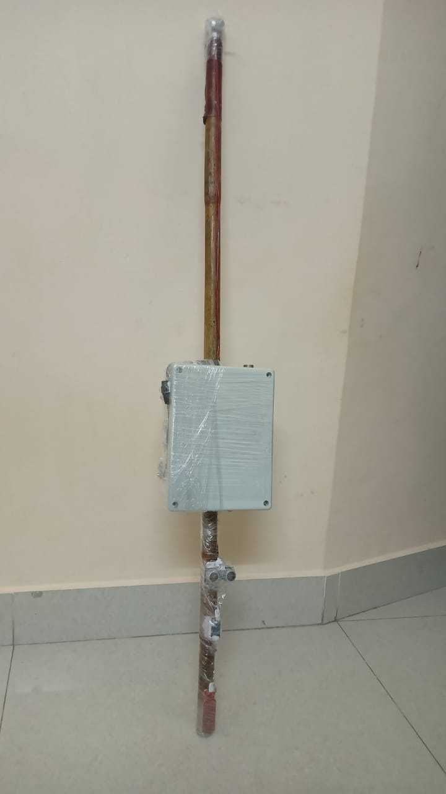
SMART ASSISTANT FOR SPECIALLY CHALLENGED PEOPLE
PROJECT GUIDE :
Dr. K. ARUL VENDHAN (AP/EEE)
PROJECT MEMBERS :
1 . KESAVA PERUMAL DN (RA2211005020002)
2 . TEJASVI RAJU (RA2211005020015)

Slide 3
Inventions are a gateway to a new world. It is a door that leads to new ways or a variety of methodologies of doing or achieving something. Moreover, the aim of inventing plenty of things is only one- to make life easy and save time. Hence, it is good if we embrace the changes that these inventions bring in our lives, to make it worth the meaning.
This particular project is one step ahead to that Invention spoken above, as it helps to lead a normal life and to do basic activities on a day – to – day basis for specially challenged People who is deprived of basic senses like speaking, seeing, hearing and paralysed.
Smart Assistant not only helps them out to do daily routines but also help them to be Independent, provide confidence and to be competent to Normal People .
The block diagram given below gives the overview of the construction and working of the Smart assistant.

Slide 4
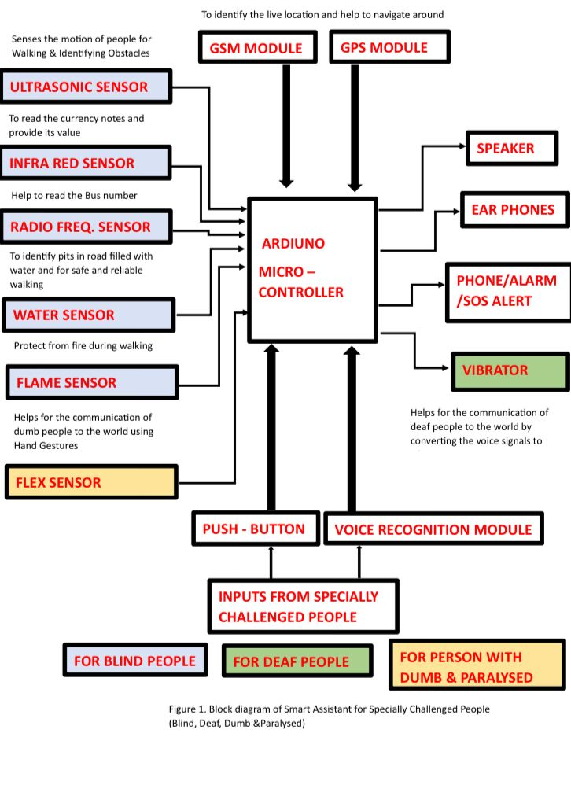

Slide 5
HARDWARE
ARDUINO MEGA
ULTRASONIC SENSOR
INFRARED SENSOR
WATER SENSOR
WATER SENSOR
FLAME SENSOR
FLEX SENSOR
GPS MODULE
GSM MODULE
EM-18 RFID READER MODULE
MP-3 MODULE

Slide 6
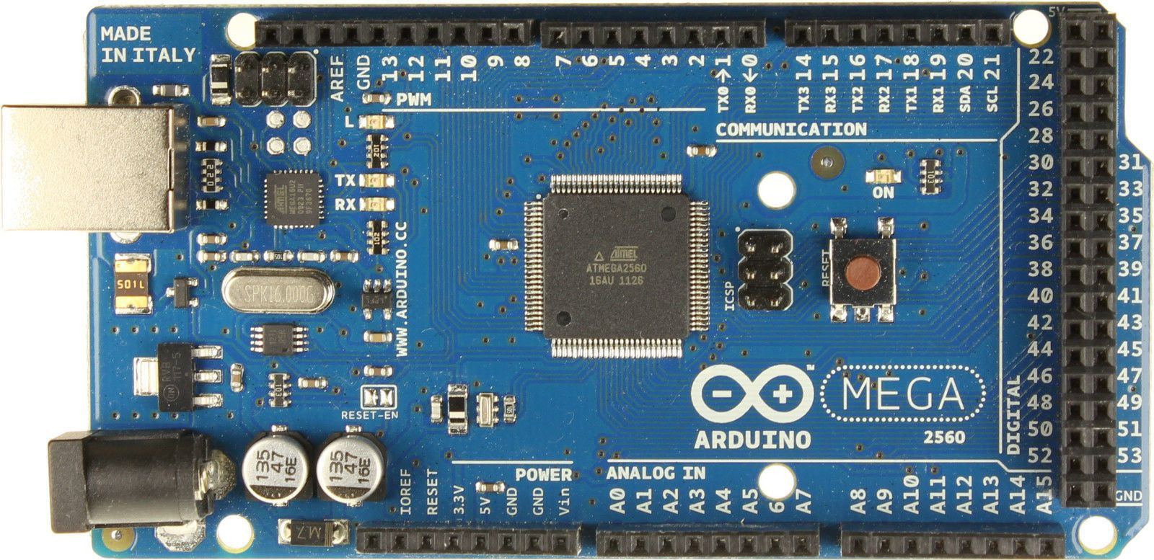
ARDUINO MEGA
It is generally used to create complex projects due to its structure.
The projects that use Arduino Mega board are IOT Applications, 3D Printers, temperature sensing, monitoring of real-time applications, etc.

Slide 7
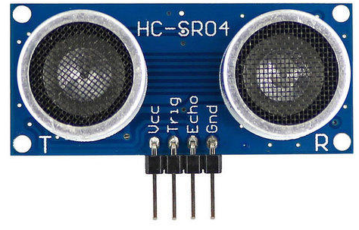
UTRASONIC SENSOR
What is an Ultrasonic Sensor? An ultrasonic sensor is an instrument that measures the distance to an object using ultrasonic sound waves.
An ultrasonic sensor uses a transducer to send and receive ultrasonic pulses that relay back information about an object's proximity.

Slide 8
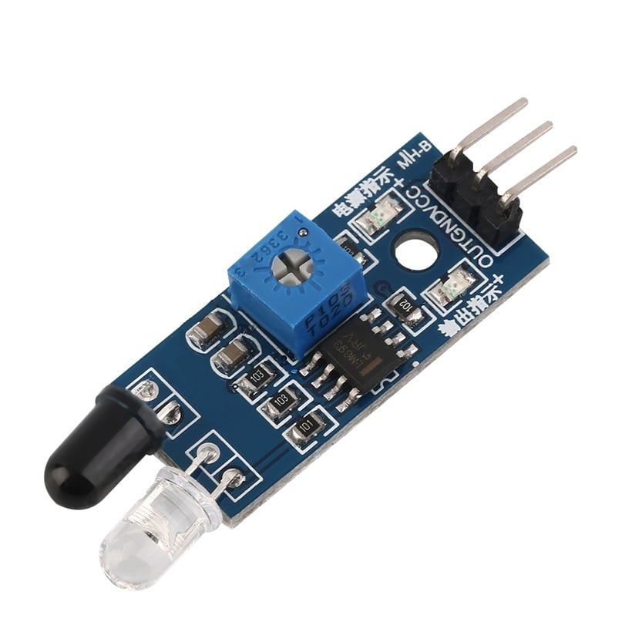
INFRA RED SENSOR
An infrared sensor (IR sensor) is a radiation-sensitive optoelectronic component with a spectral sensitivity in the infrared wavelength range 780 nm … 50 µm.
IR sensors are now widely used in motion detectors, which are used in building services to switch on lamps or in alarm systems to detect unwelcome guests.

Slide 9
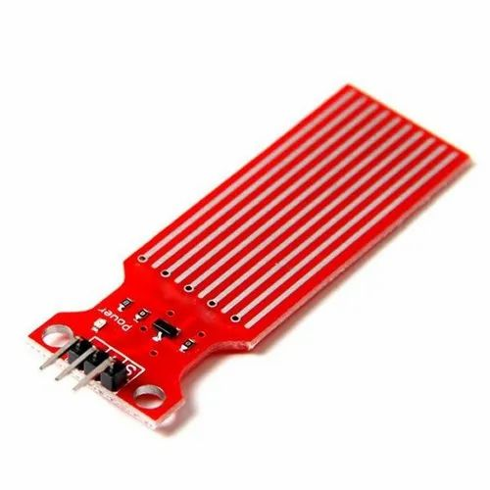
WATER SENSOR
Water sensors detect the presence of water and, when placed in locations where water should not be present, a leak.
When Wi-Fi is enabled, the sensor can send out a notification to the homeowner through a smartphone app.

Slide 10
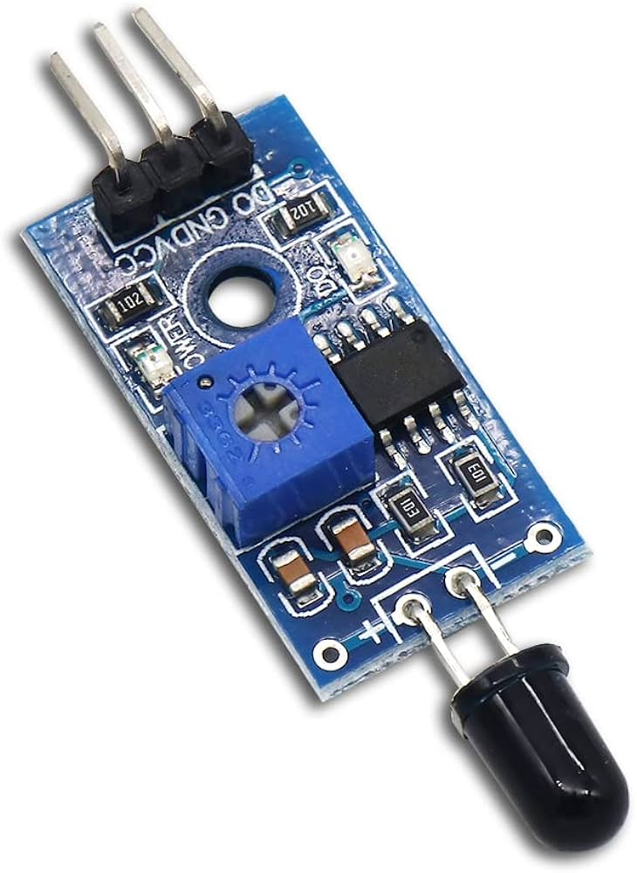
FLAME SENSOR
This type of flame detector works by detecting the UV radiation at the point of ignition.
Almost entirely all fires emit UV radiations, so in case of the flame, the sensor would become aware of it and produce a series of the pulses that are converted by detector electronics into an alarm output.

Slide 11
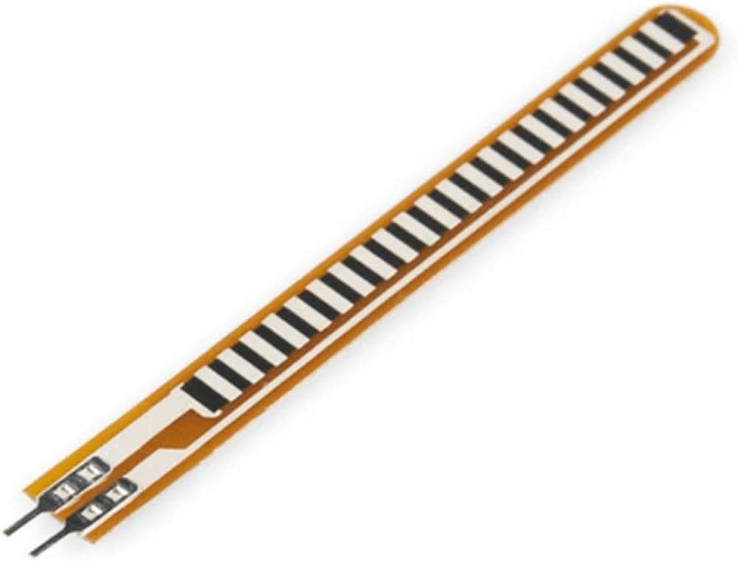
FLEX SENSOR
A flex sensor or bend sensor is a sensor that measures the amount of deflection or bending.
Usually, the sensor is stuck to the surface, and resistance of sensor element is varied by bending the surface.

Slide 12
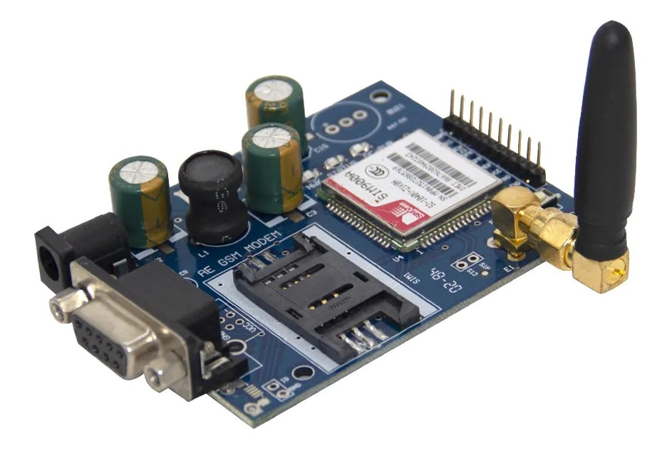
GSM MODULE
The GSM module plays a crucial role in the communication between devices and the GSM network.
It is responsible for establishing and maintaining the communication link between the device and the network.
The module also handles the encryption and decryption of data, which ensures the security of the communication.

Slide 13
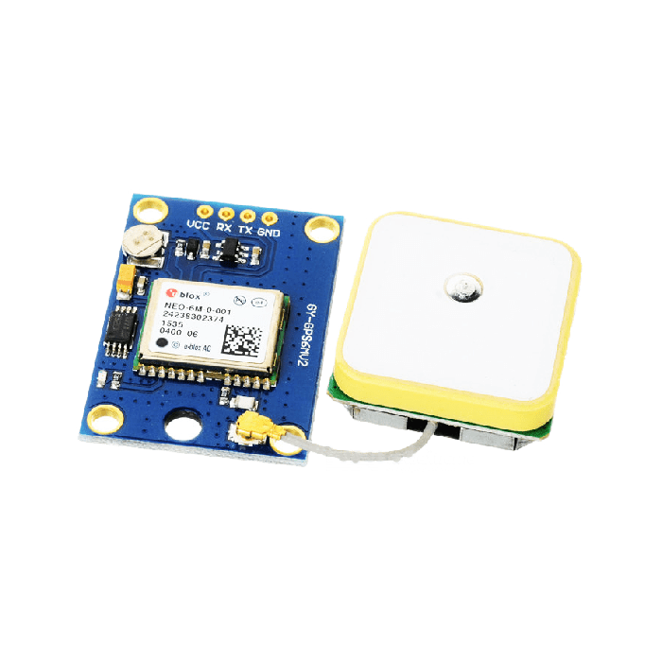
GPS MODULE
The Global Satellite Positioning System
The GPS module is a wireless chip module combined on the mainboard of a mobile phone or machine.
It can communicate with the global satellite positioning system in the United States.
It can locate and navigate according to the condition of a wireless network signal.

Slide 14
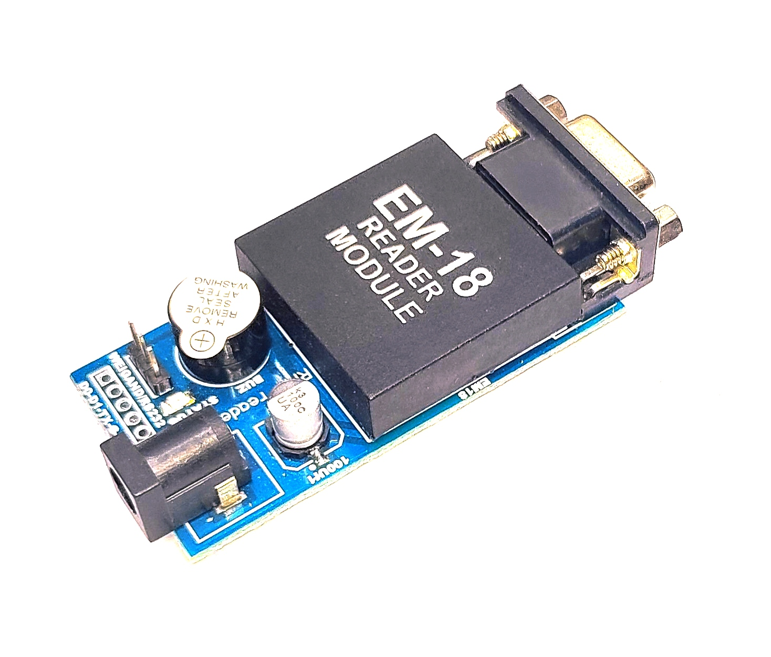
EM18 RFID Reader Module
EM18 is a RFID reader which is used to read RFID tags of frequency 125 kHz.
After reading tags, it transmits unique ID serially to the PC or microcontroller using UART communication or Wiegand format on respective pins.
EM18 RFID reader reads the data from RFID tags which contains stored ID which is of 12 bytes.

Slide 15
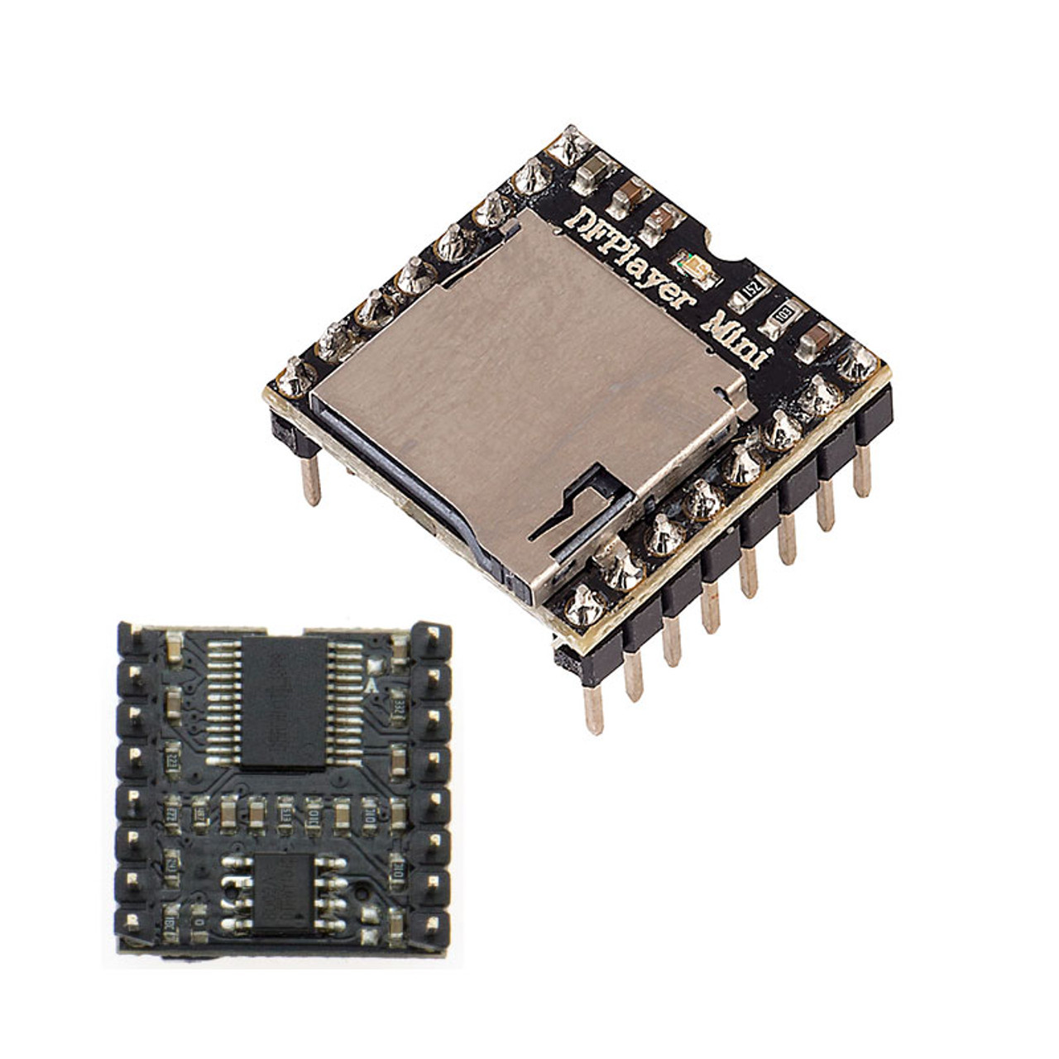
MP3 Module
The module has an onboard TF SD card slot to store the record data as well as playback whenever you want, or you can easily transport the recorded MP3 file to any device via SD card.
The module has two separate 3.5 mm jacks for audio Out & Microphone In and Onboard Microphone for recording.

Slide 16
SOFTWARE

Slide 17


